Slide 1
Understanding the Weighted Grade System
What is a weighted system?
A weighted system calculates individual grade items as a percentage of a whole. The final grade totals to 100%. Individual grade items can have maximum points of any value, but their contribution towards the category they belong to and the final grade is the percentage value (weight) assigned to them.
How do graded items function in a weighted system?
Grade items in a category count as a percentage of their category, not of the course’s final grade. Therefore, grade items in a category should combine to a weight of 100%.
For example, if you have a category worth 10% of the final grade with two equally weighted grade items, the weight of each grade item is 50% (its contribution to the category) not 5% (its contribution to the final grade).
Keep in mind…
The final grade of the course is inaccurate until ALL gradable items are accounted for. Releasing a calculated final grade before your course ends could be misleading. Desire2Learn will produce a warning message if your grade items do not add up to 100%. This warning can be ignored, and upon doing so, Desire2Learn will auto adjust all categories to add up to 100%.
What’s next?
The following pages are a refresher designed to help you within Desire2Learn while creating, updating, and using a weighted grade system for your course.
*Click on Grades in the Navbar to access the tool.

Slide 2
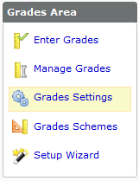
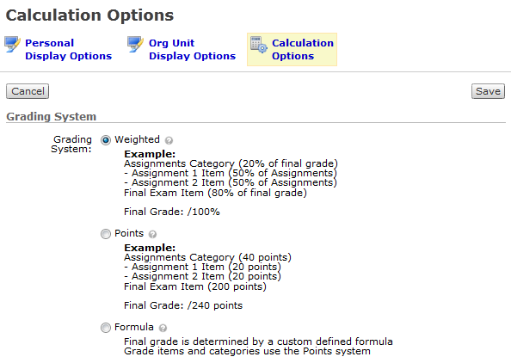
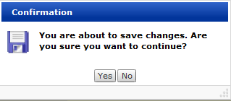
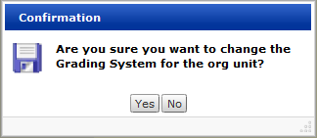
Selecting a Weighted System
To select a weighted system:
Click Grades Settings in the Grades Area.
Select Calculation Options.
Choose Weighted.
Click Save.
Answer Yes in the first confirmation message.
Answer Yes in the second confirmation message.
2
1
3
4
NOTE: In this case, “org unit” refers to your course.
5
6

Slide 3
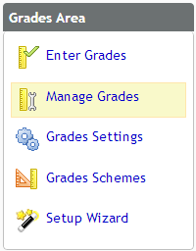

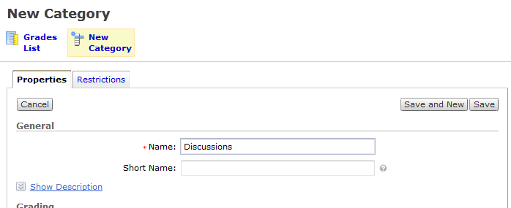
Creating Grade Categories
To create a new grade category:
Click Manage Grades.
Click New Category.
Give the category a Name.
1
2
3

Slide 4
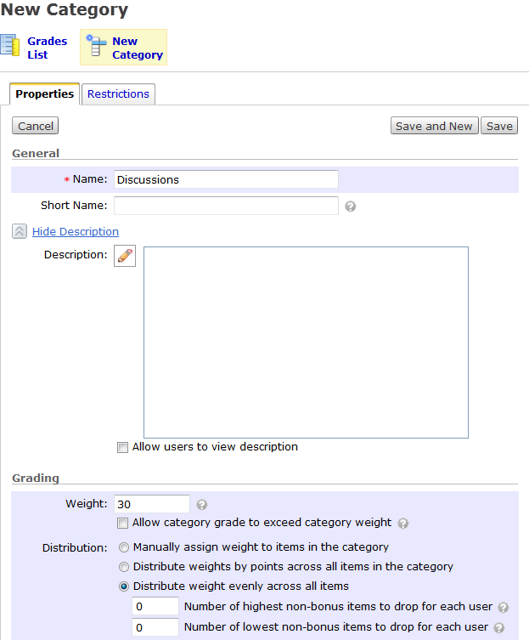
Creating Grade Categories (cont.)
Enter a Description.
Enter the total Weight. In this example the Category is weighted 30%.
Choose the category’s Distribution. In this example, all items will be weighted the same in the category.
Click Save and New.
7
This is where you provide a description of the category.
4
5
6

Slide 5

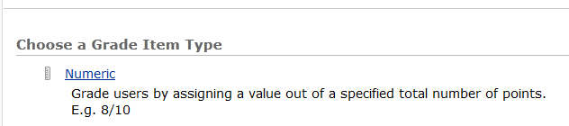
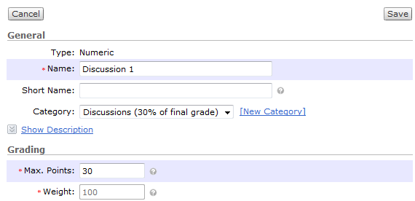
Creating Weighted Grade Items
To create a new grade item:
Click New Item.
For grade items that will be connected to Discussions, Dropbox folders, and Grades, choose Numeric.
Enter a Name for the item. In this example, it’s called Discussion 1.
Choose its Category.
Choose the Max Points. In this example the item is worth 15 points.
Click Save and New.
Repeat steps 2 through 6 until all items for the category have been created.
1
2
6
3
5
4
15

Slide 6
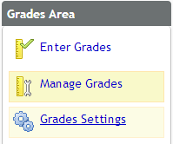
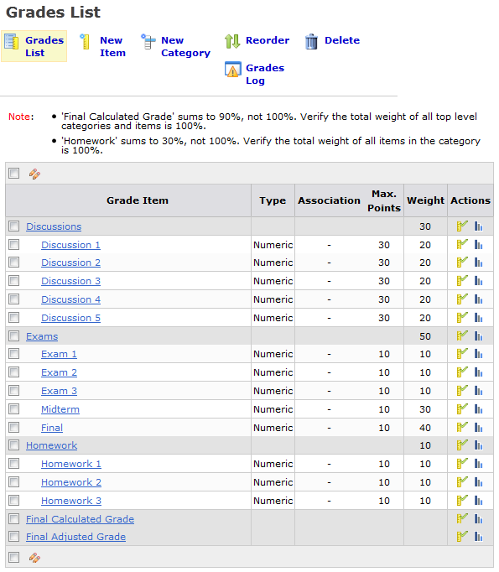
Viewing the Grades List
To view your grades list:
Click Manage Grades in the Grade Areas menu.
The Grades List displays the categories and grades you created along with information about them.
1
2

